Slide 1




Anjez
أنـــجـــز

Slide 2
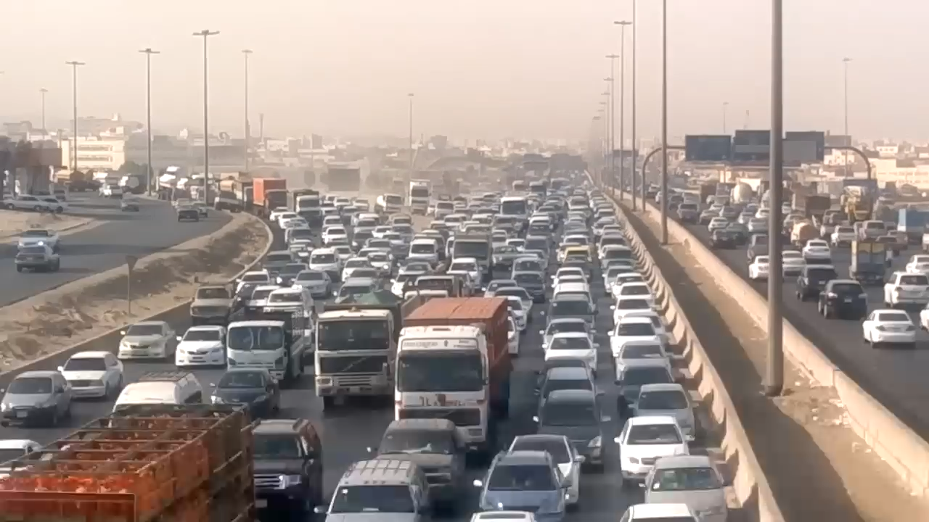
Why Anjez ? ☺

Slide 3
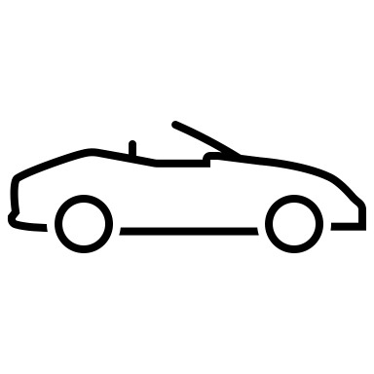

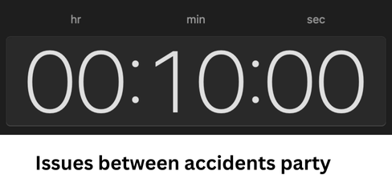
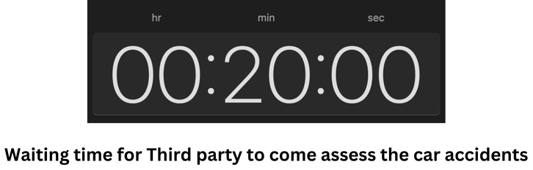
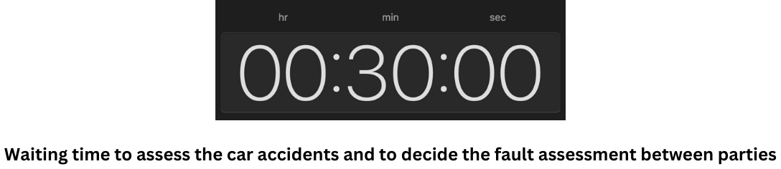
Problem
The full time for this process will take around one to two hours, which will cause heavy traffic

Slide 4
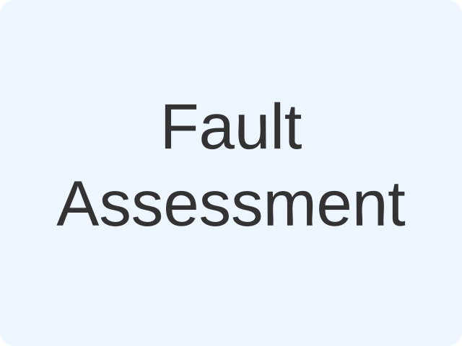

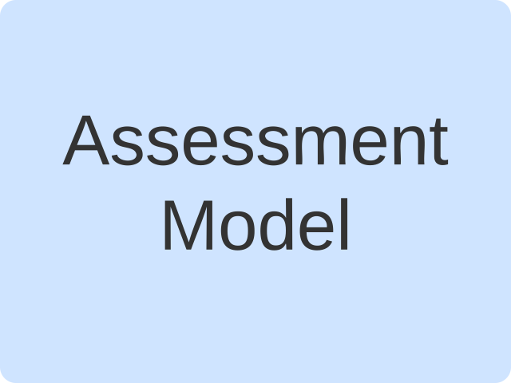
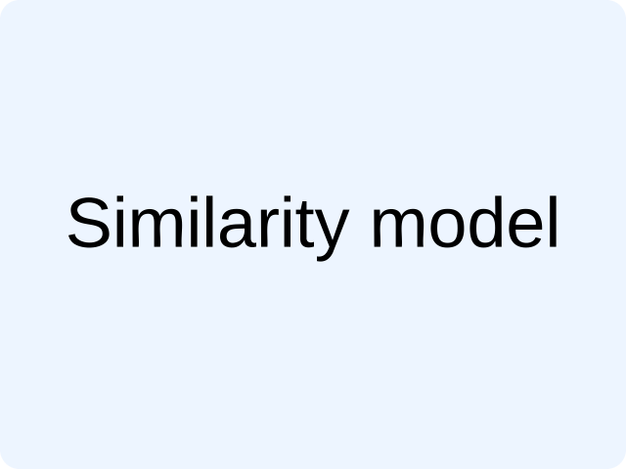

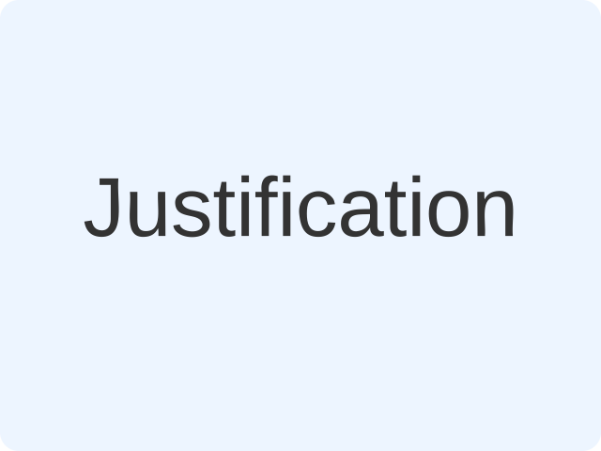
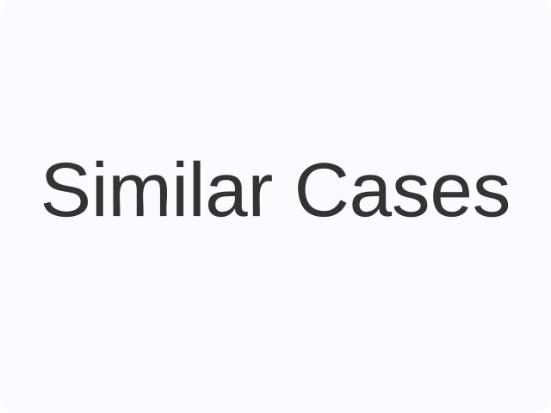
Our solution
Image
Description

Slide 5
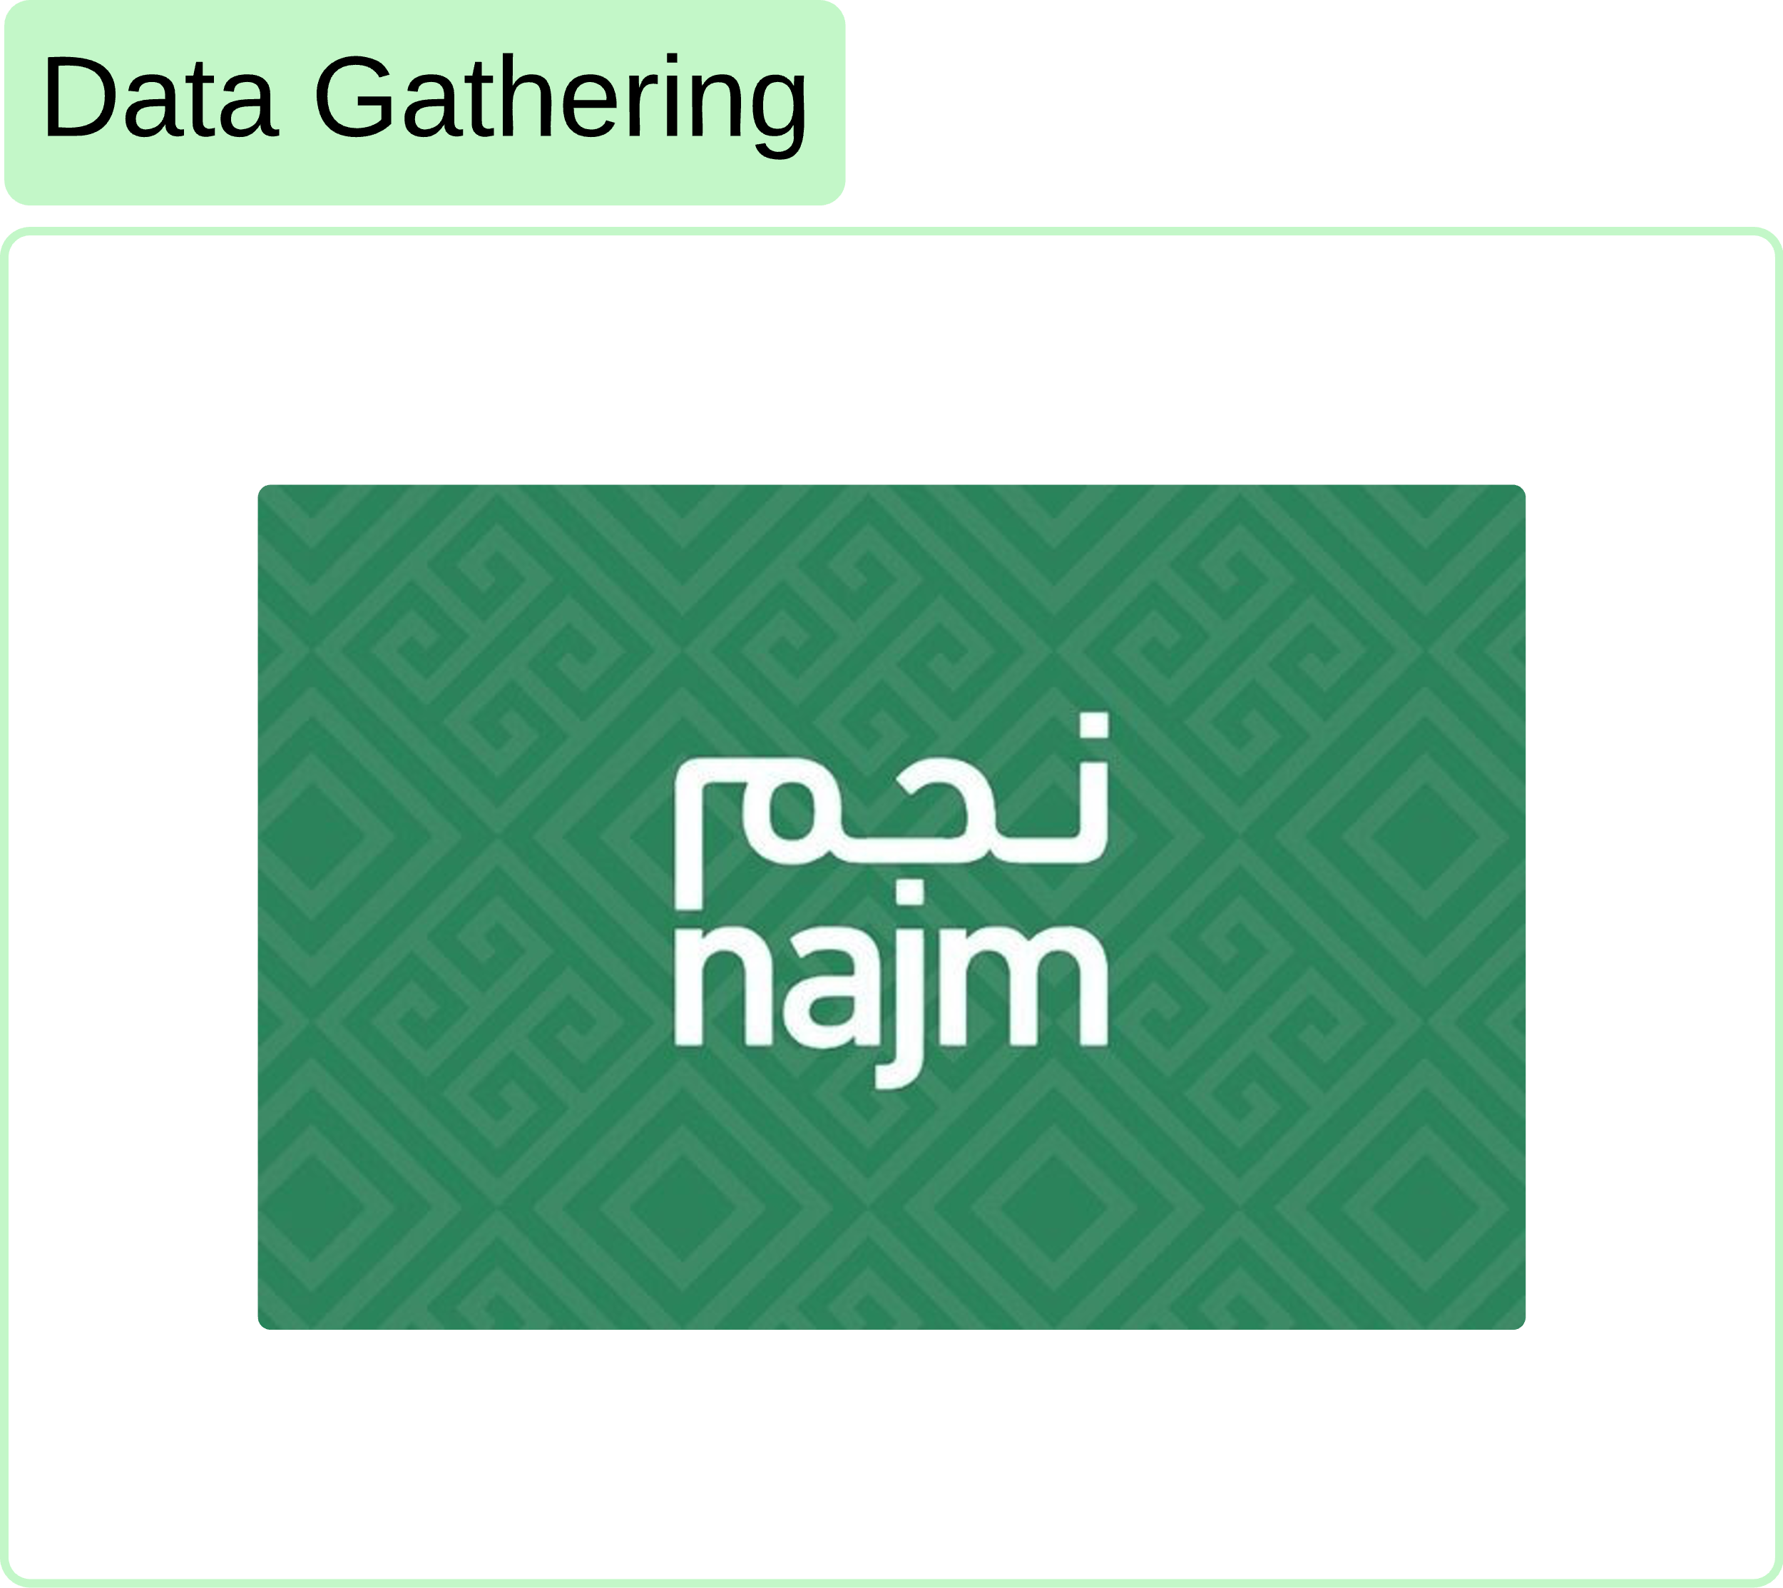
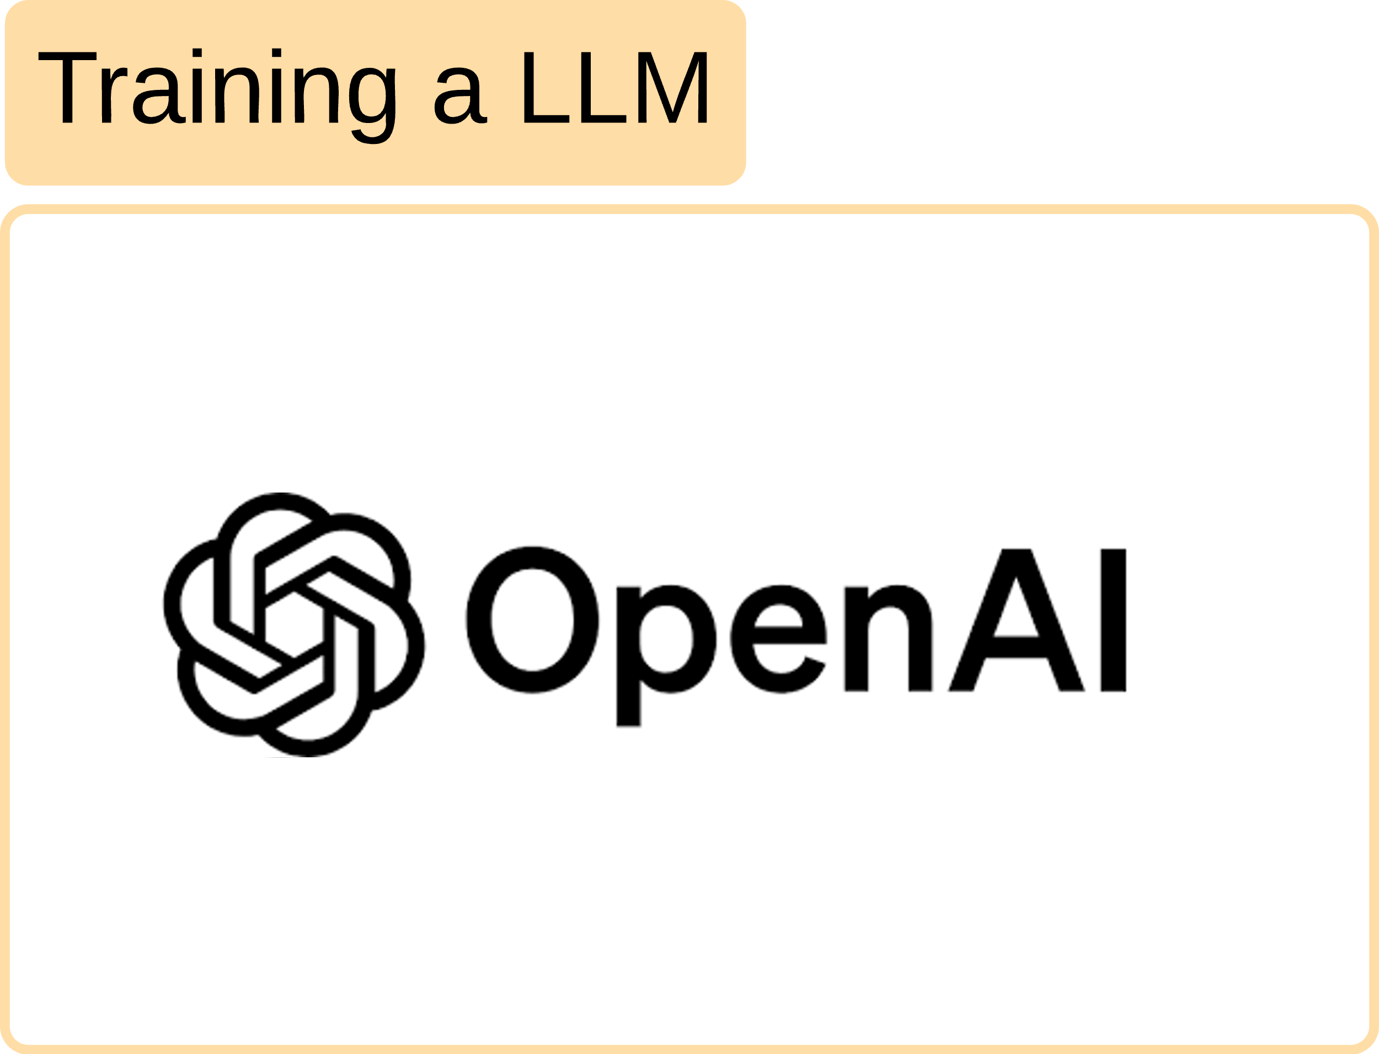

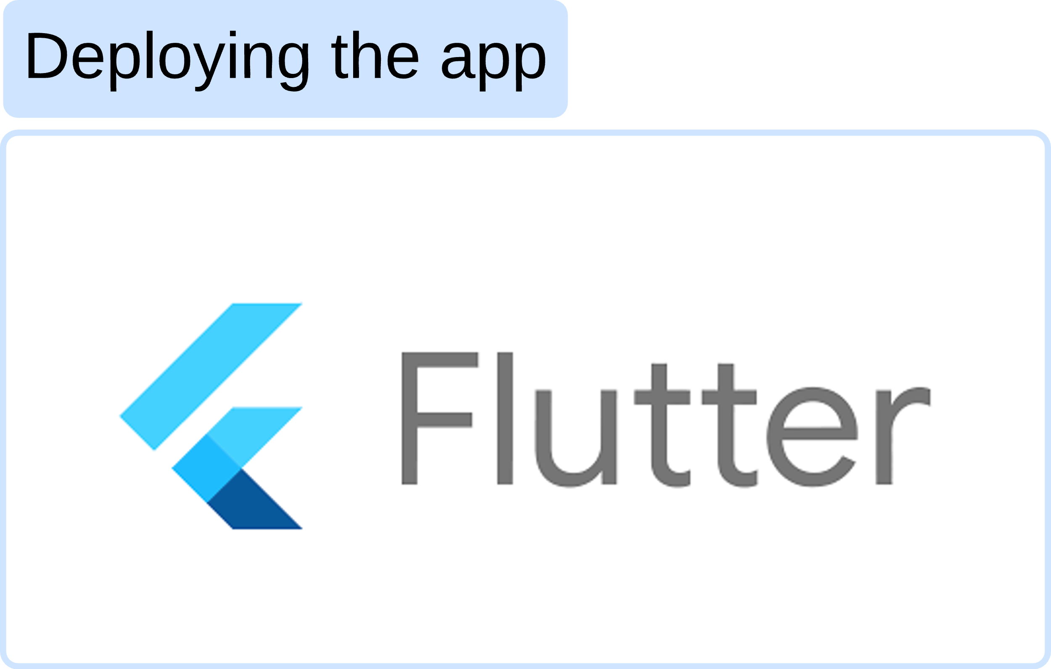
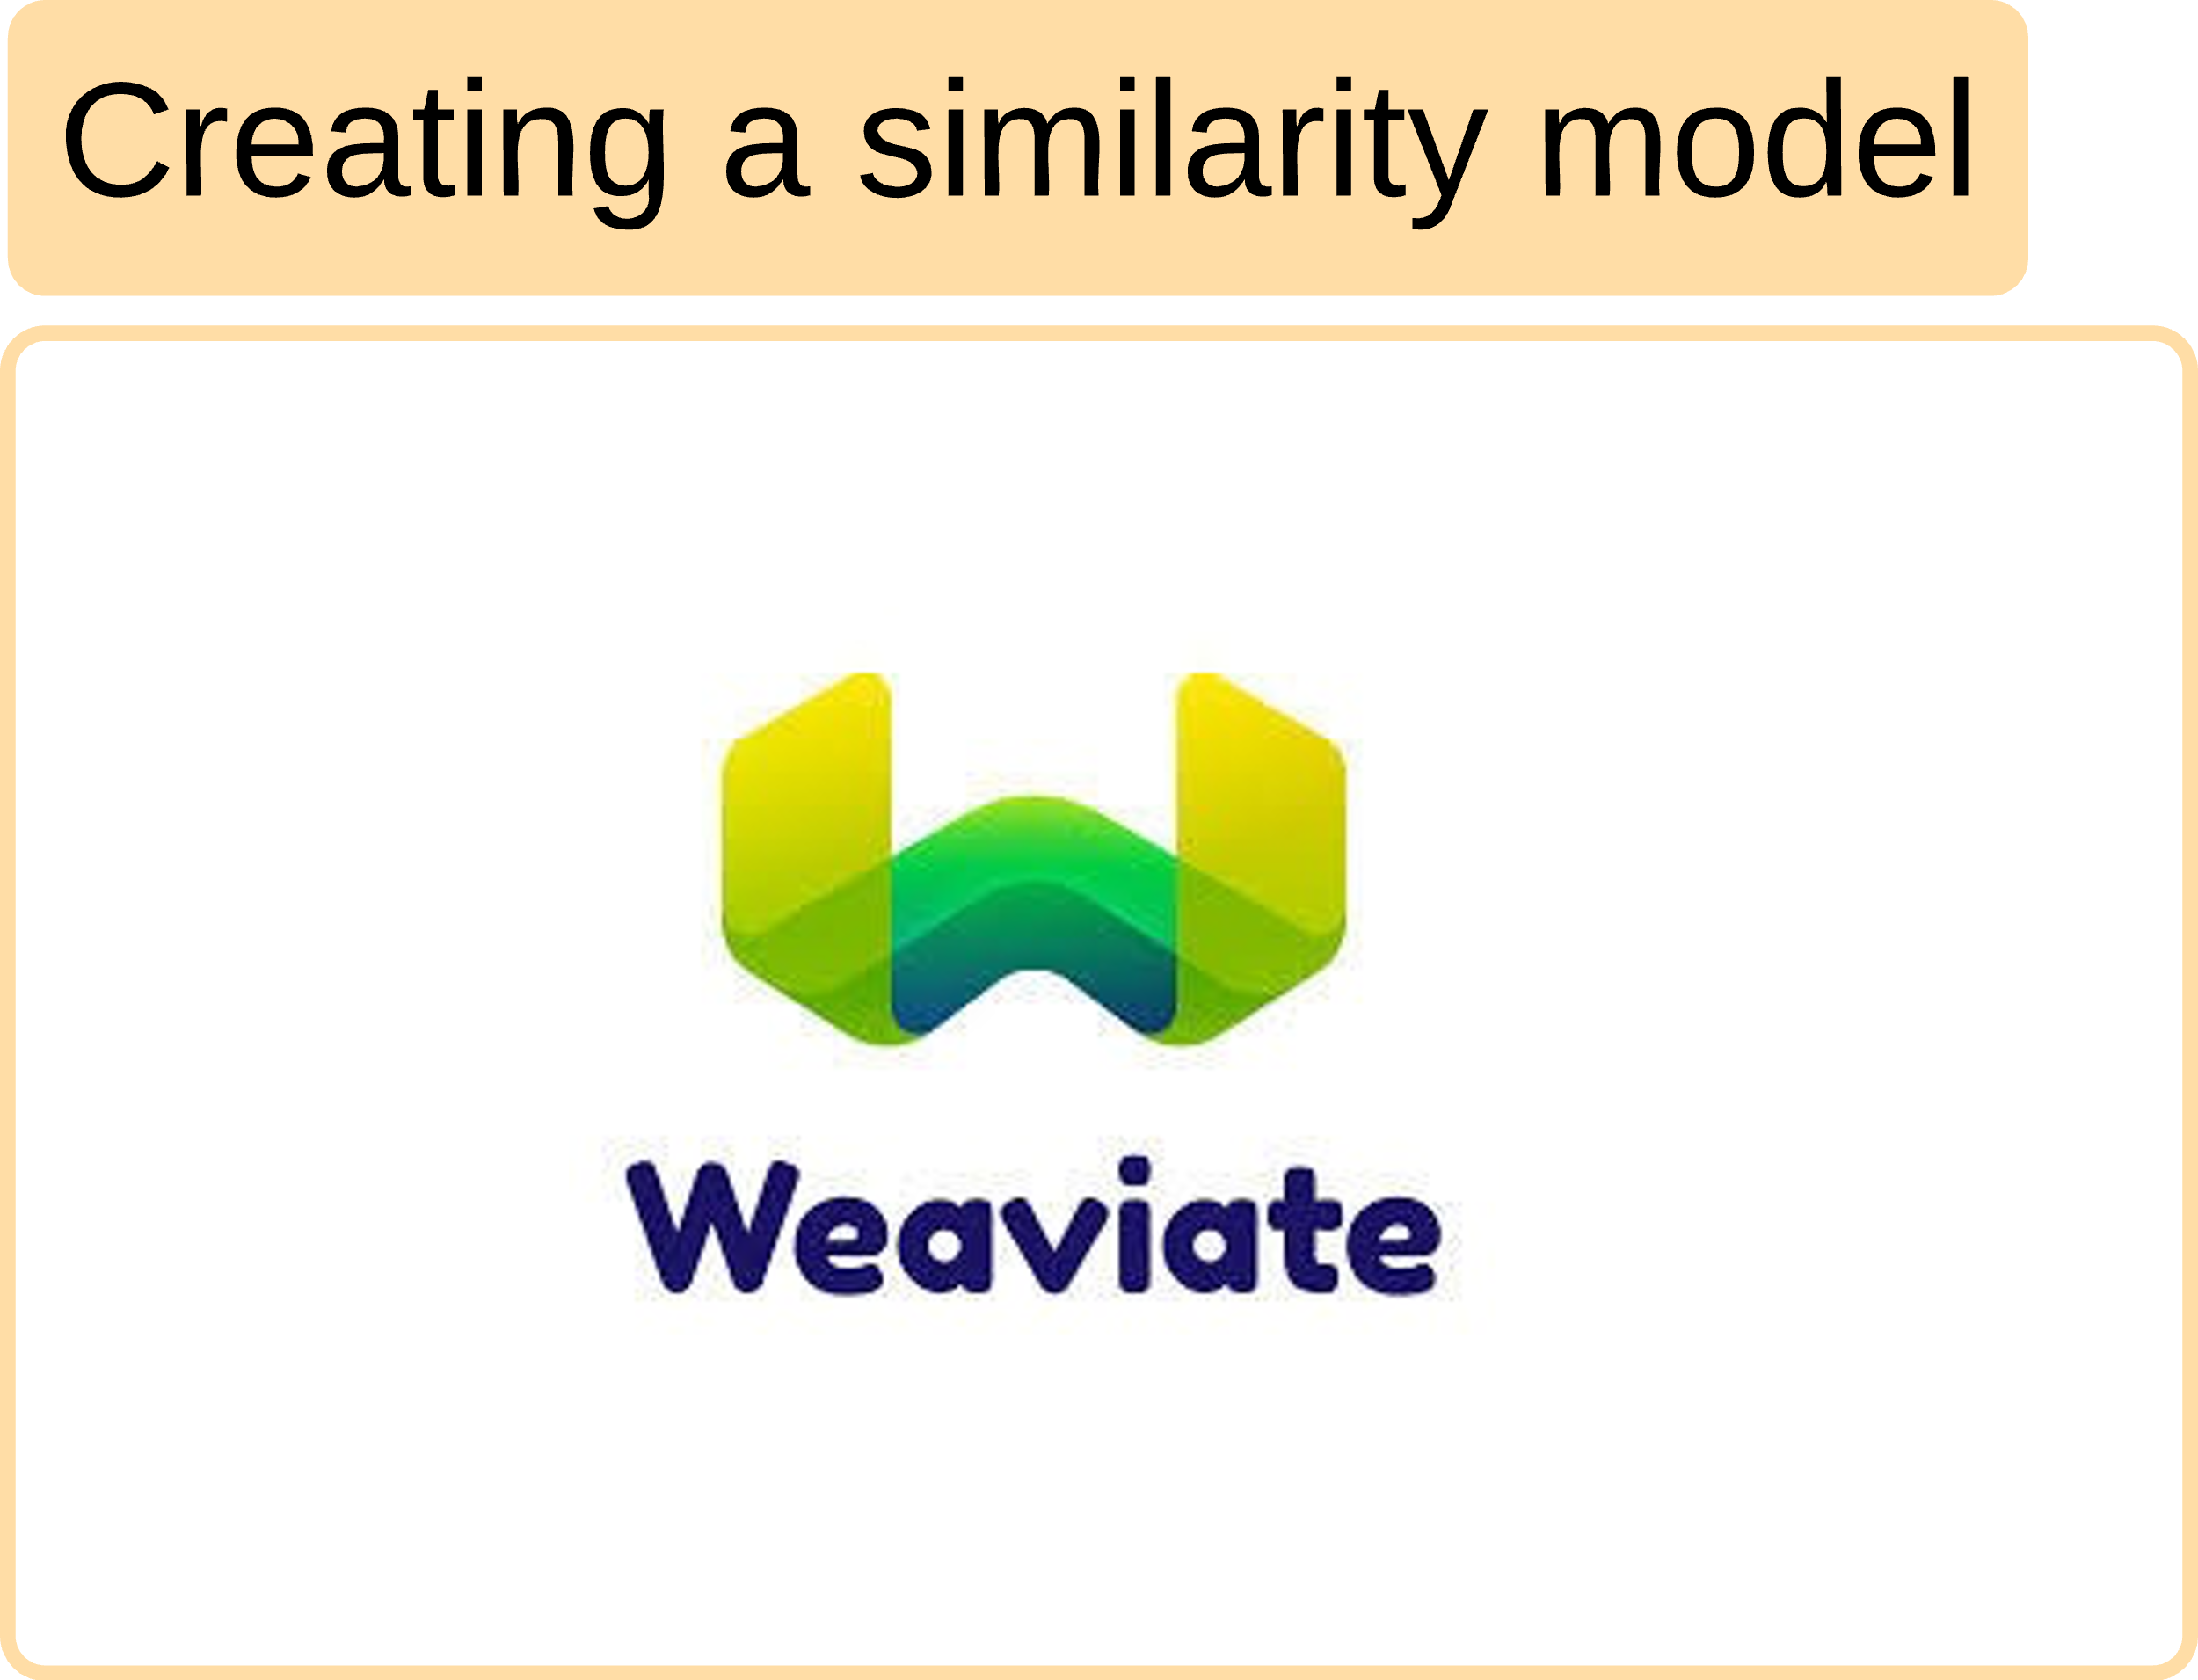
Our Pipeline

Slide 6

Data overview
We tried to take crash data from Najm
They told us to get permission from the insurance authority ☹

Slide 7

Data overview
When we arrived the told us its not from our side, you need to get the data from Najm ☹
They told us that we must submit an official request and “hopefully” they will come back to us after 10 workdays ☹
Anjez Team What we gone do ??
Let's Come Back for Najm ☹

Slide 8
Data overview
Hi, Again! ☺
Go Out !! ☹
We tried to take crash data from Najm
They told us to get permission from the insurance authority ☹

Slide 9
Data overview
فريق أنــجــز تعرفون واسطة ؟؟
خـالـد: عندي ازهلو

Slide 10

Data overview
After that we tried to contact the Moroor for some data.
they provided a sample, but it only had severe crashes that we couldn’t use for our model.
Mood: Anjez Team ☹

Slide 11
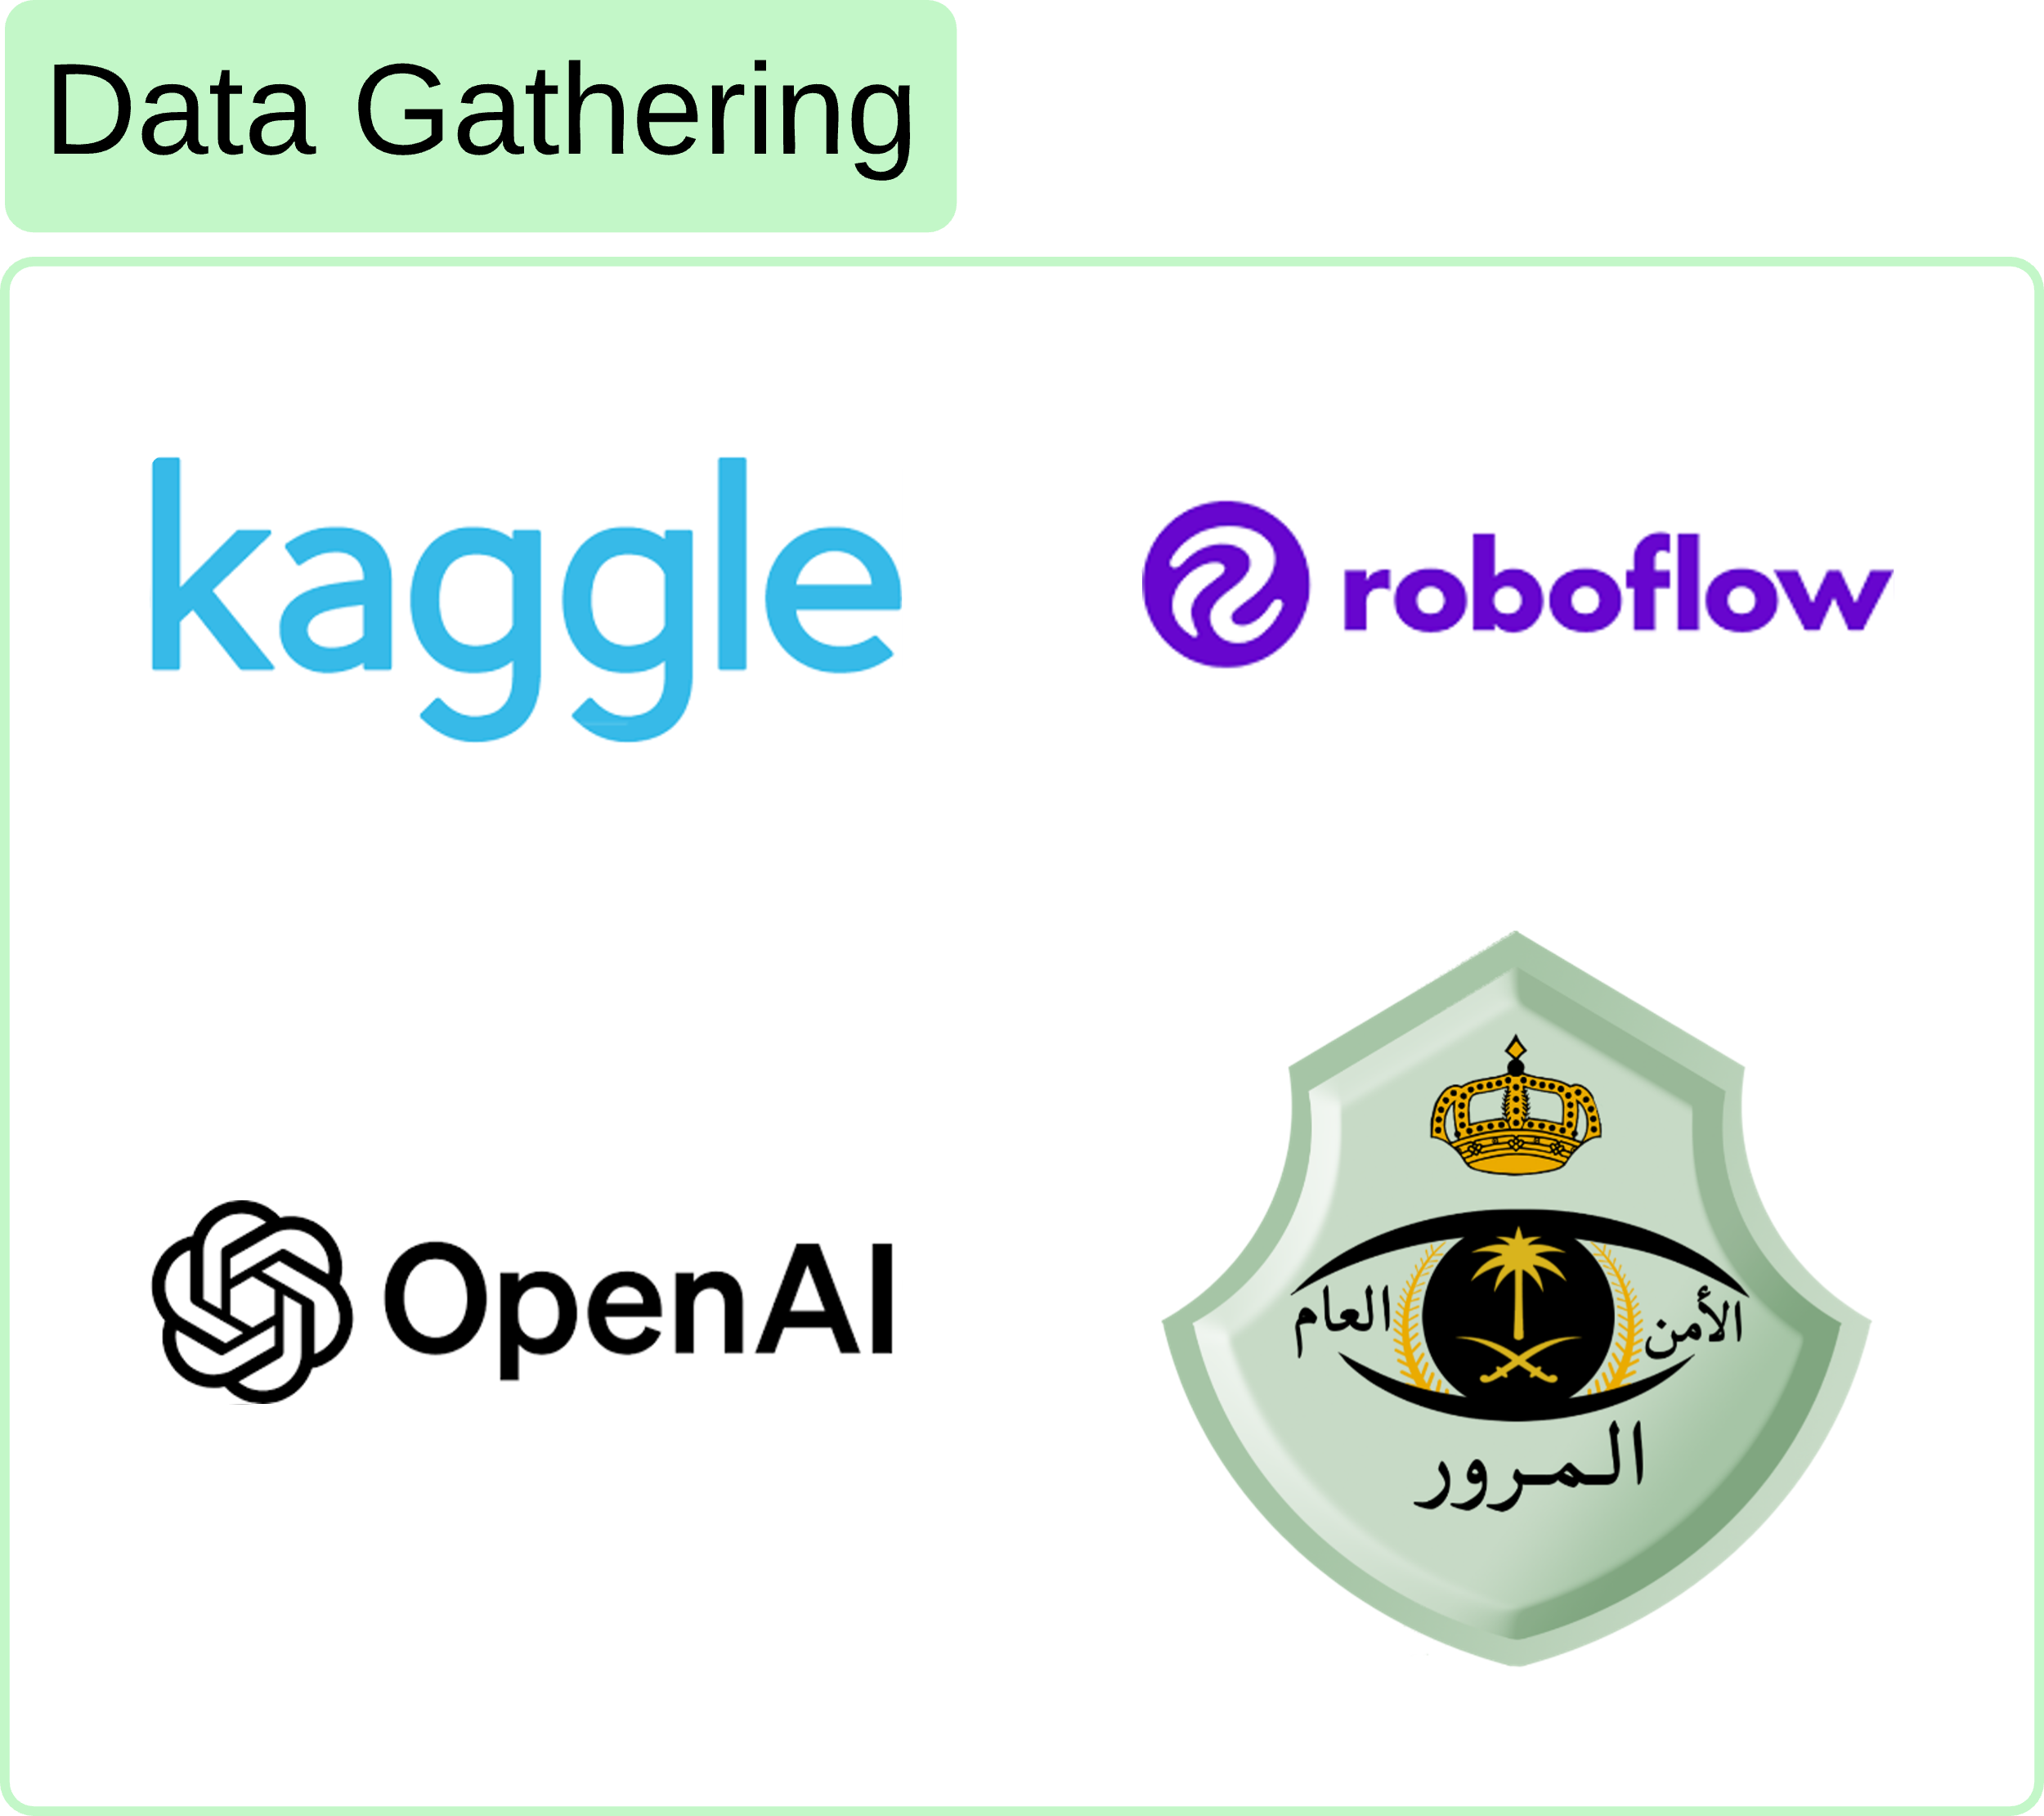
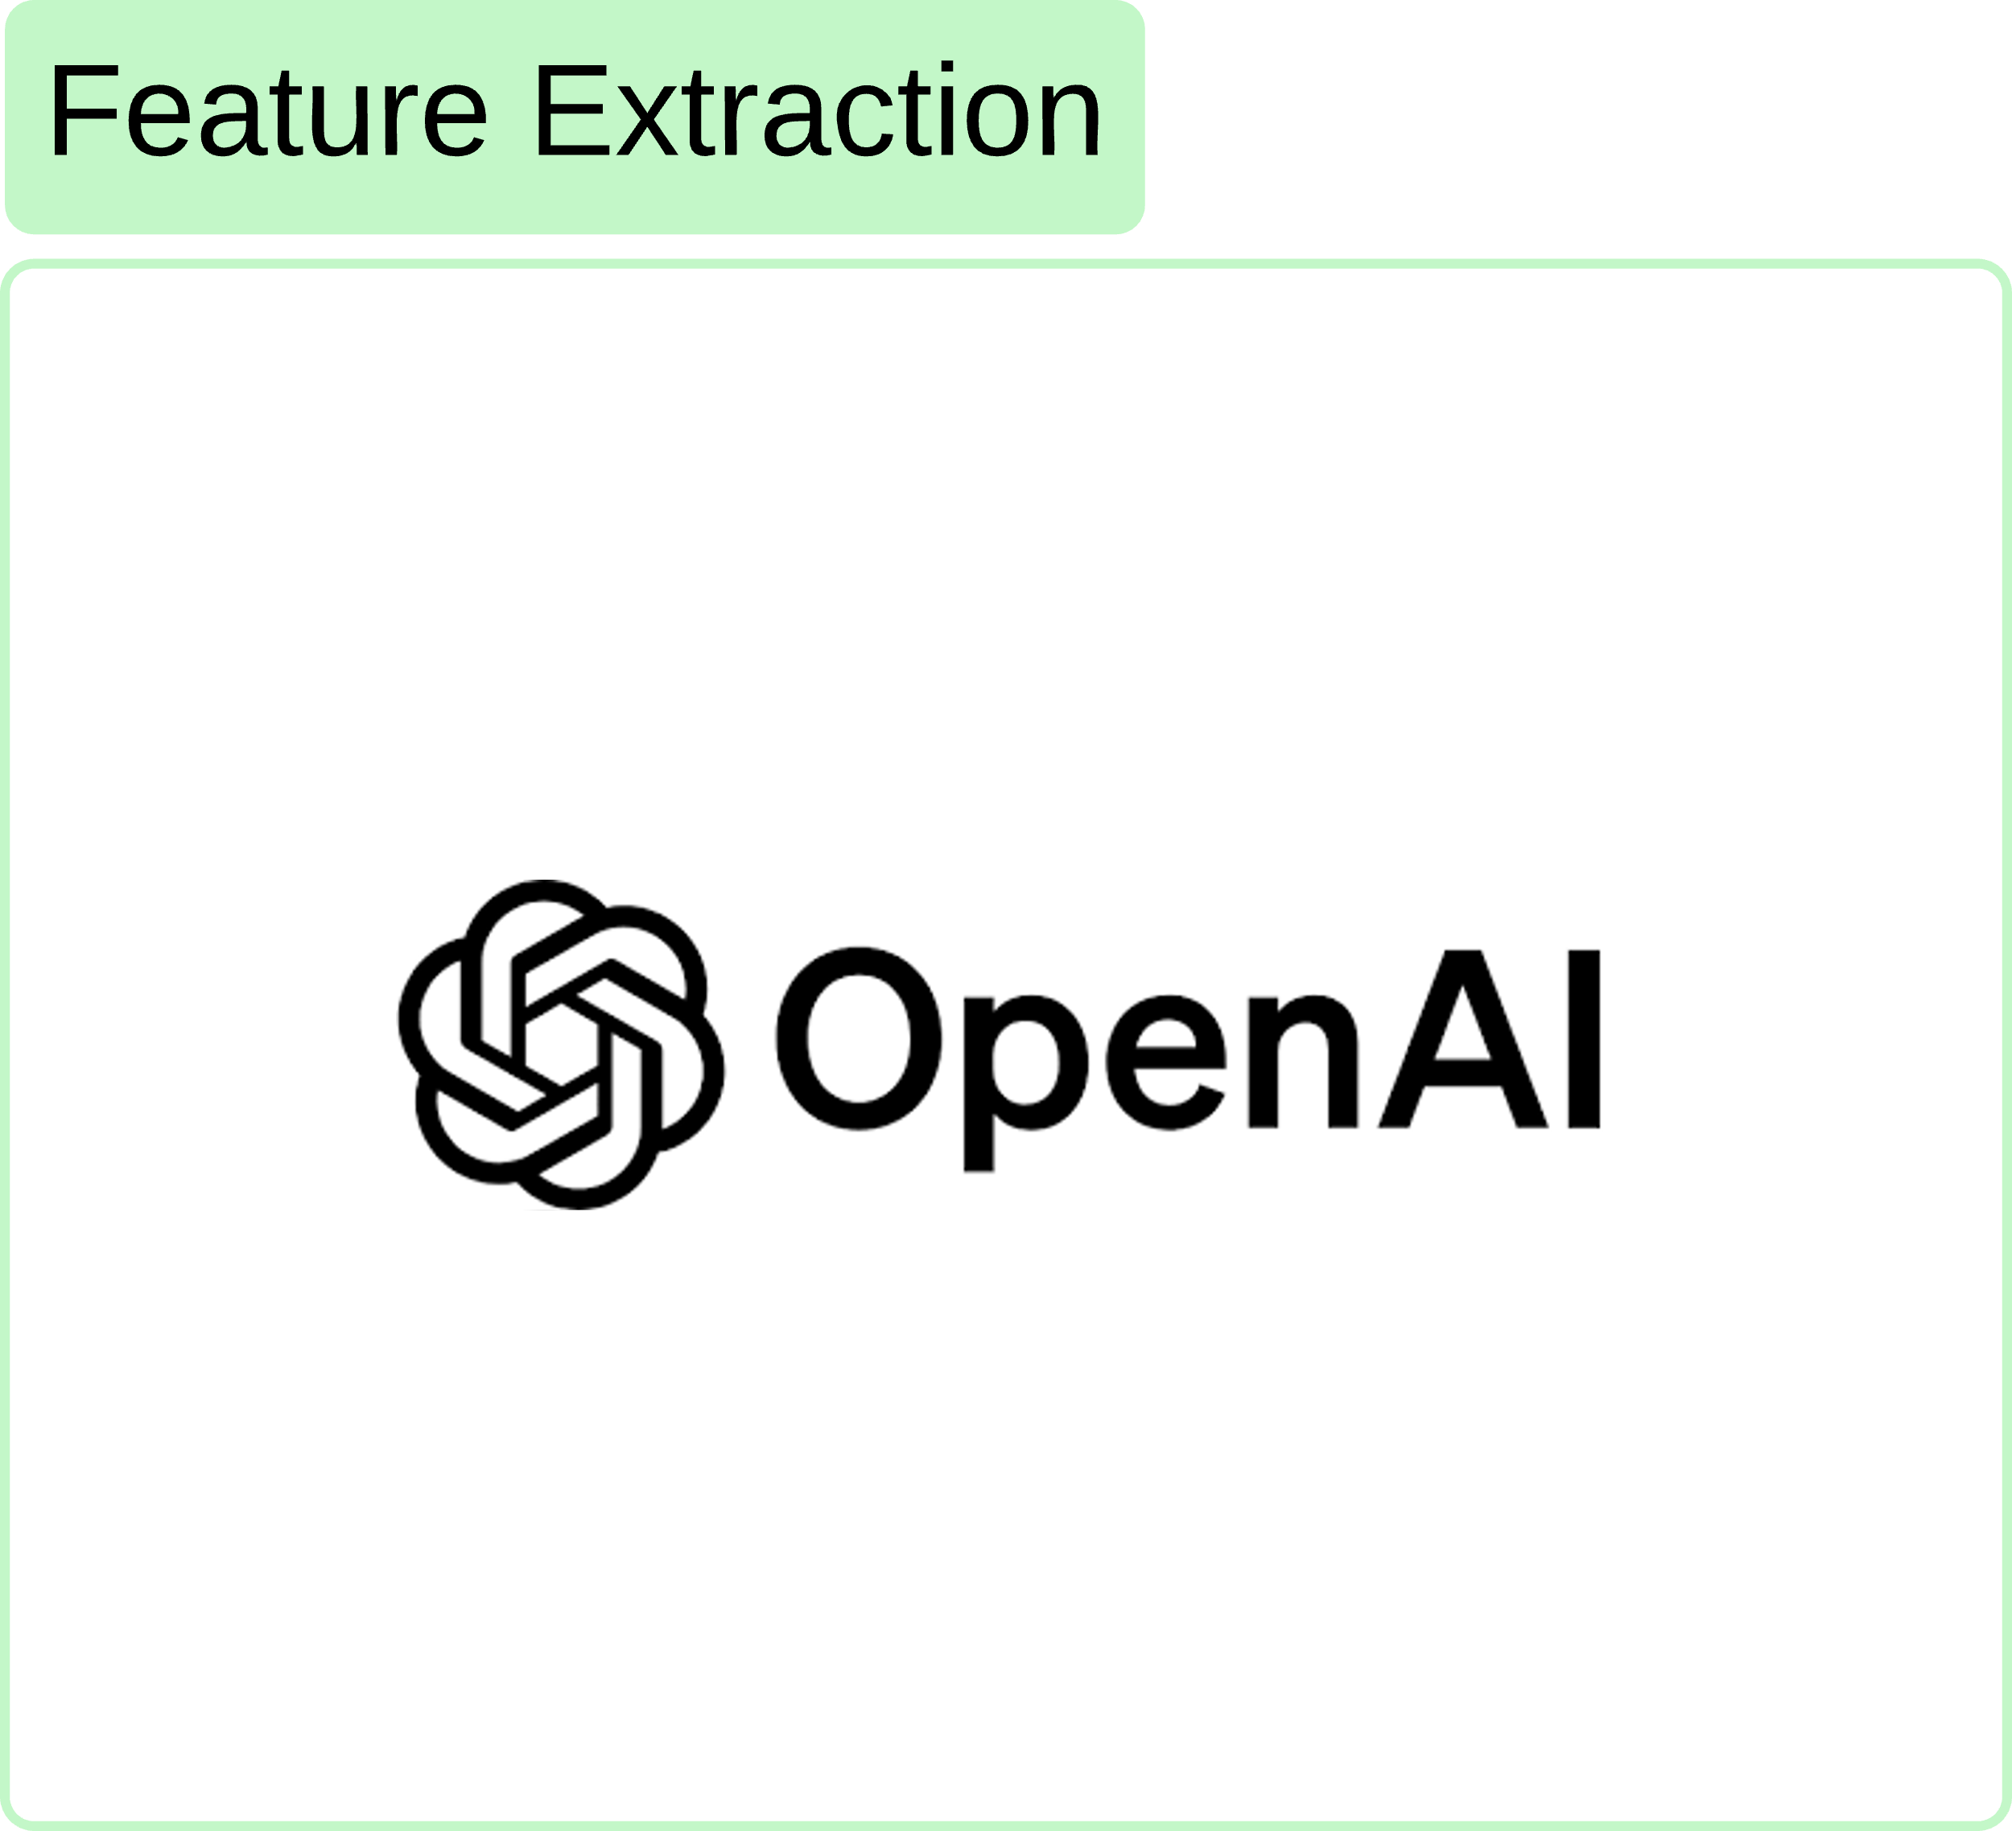
Our new Pipeline

Slide 12
Our Data

Slide 13
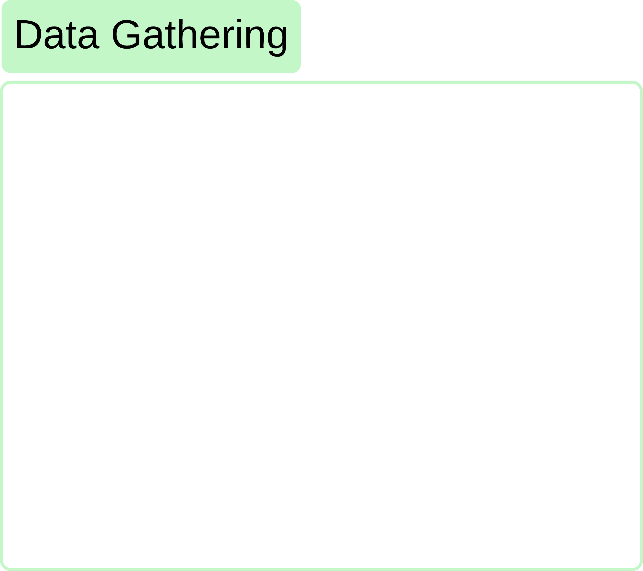
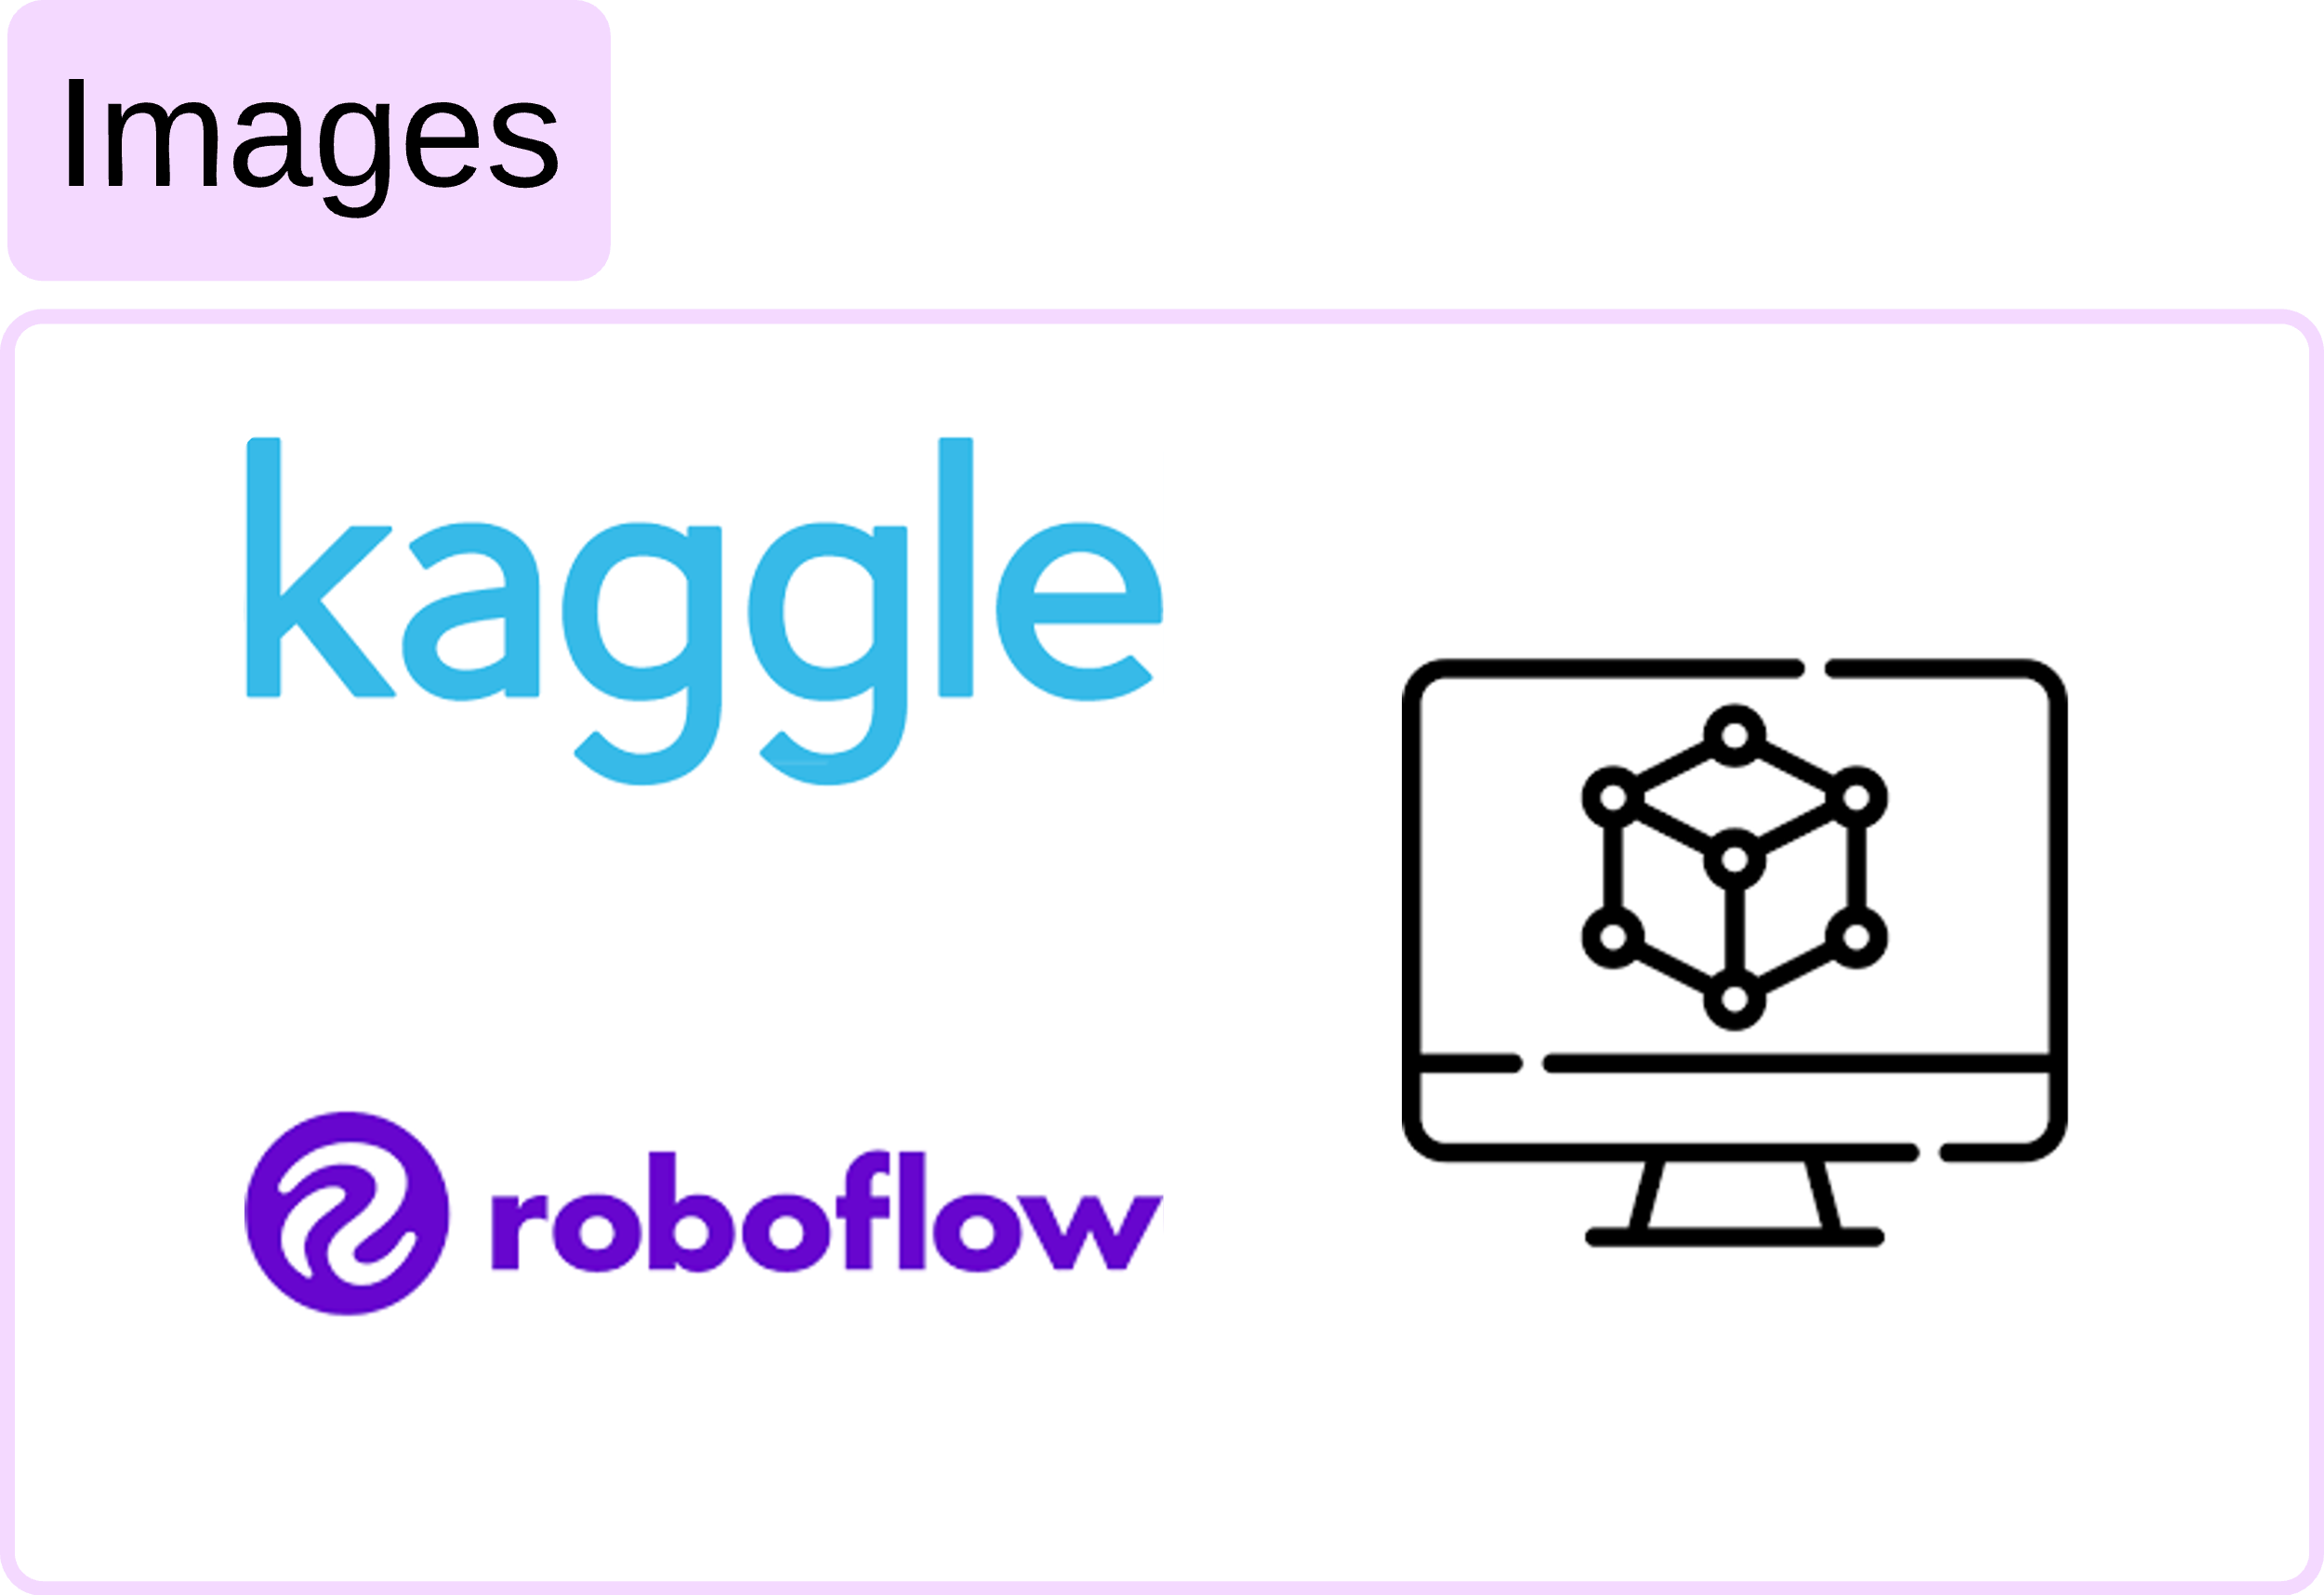
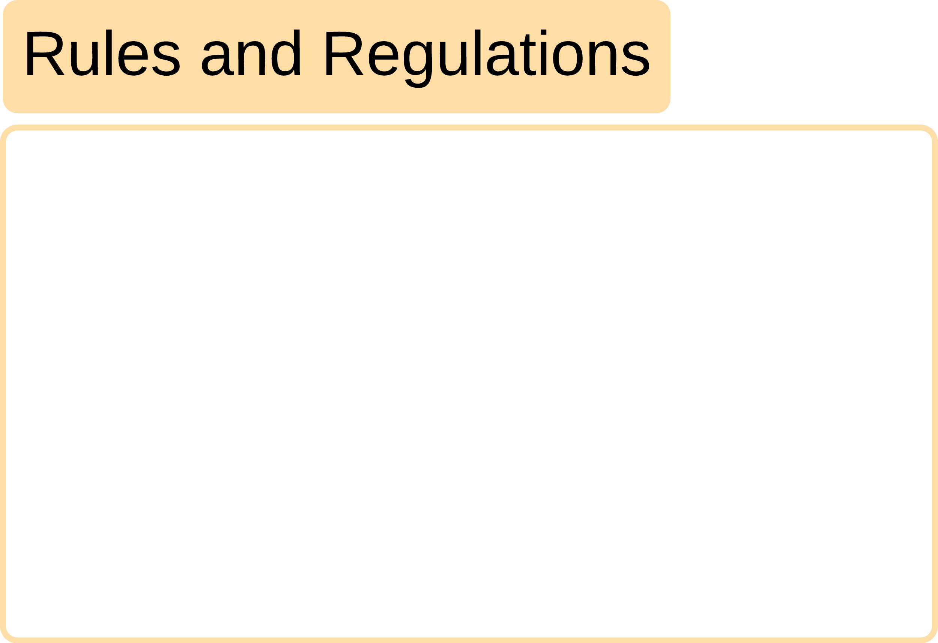

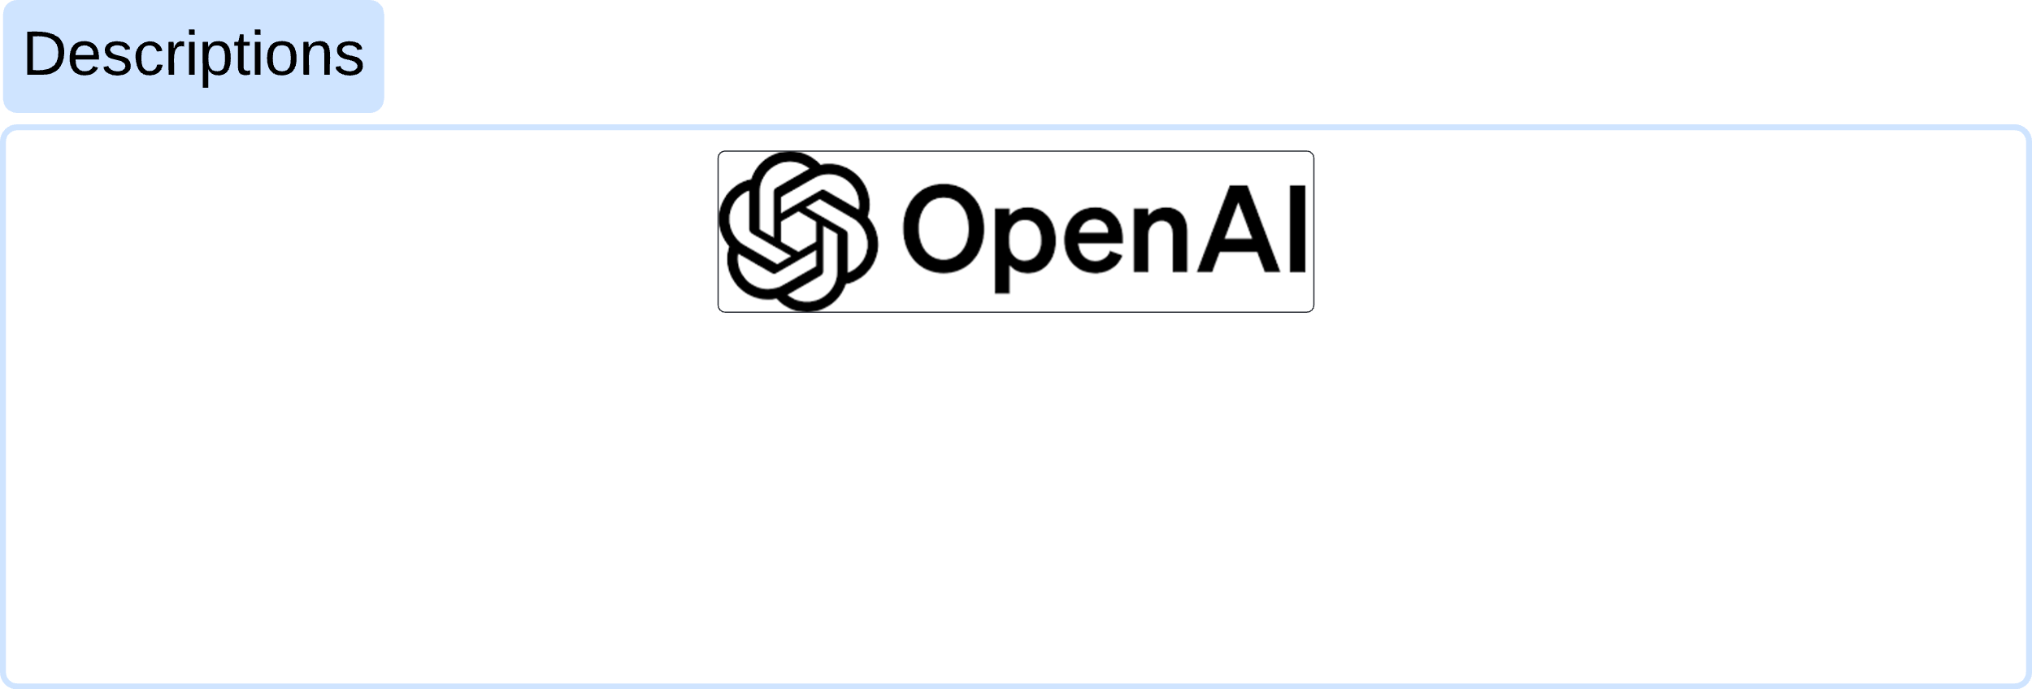



300 row
75 image
اللائحة التنفيذية لنظام المرور السعودي الصادر بالقرار الوزاري رقم ٢٢٤٩ وتاريخ ١٤٤٠/٠٣/١٠ هـ
4 scenarios

Slide 14


Data Modeling
We trained an LLM agent From OpenAI on our data and the rules and regulations of traffic in Saudi Arabia.
We used it as our final model.

Slide 15
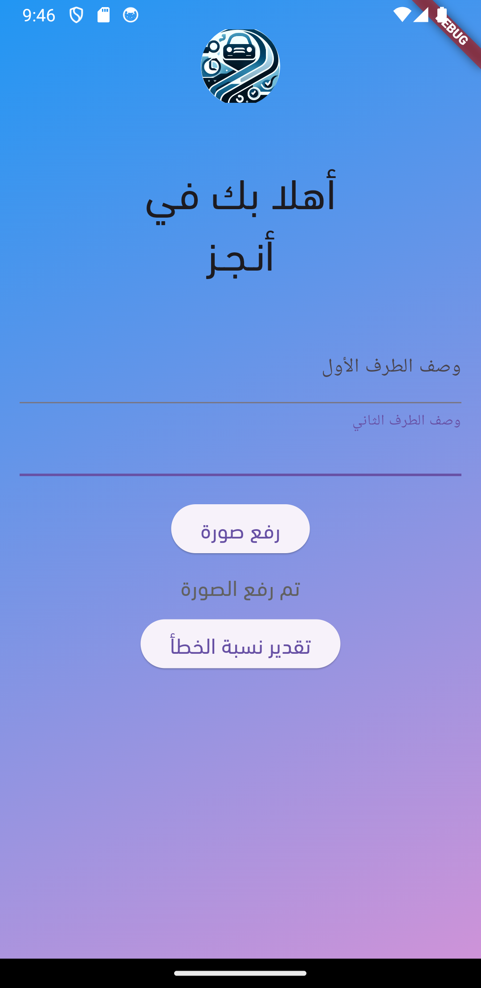
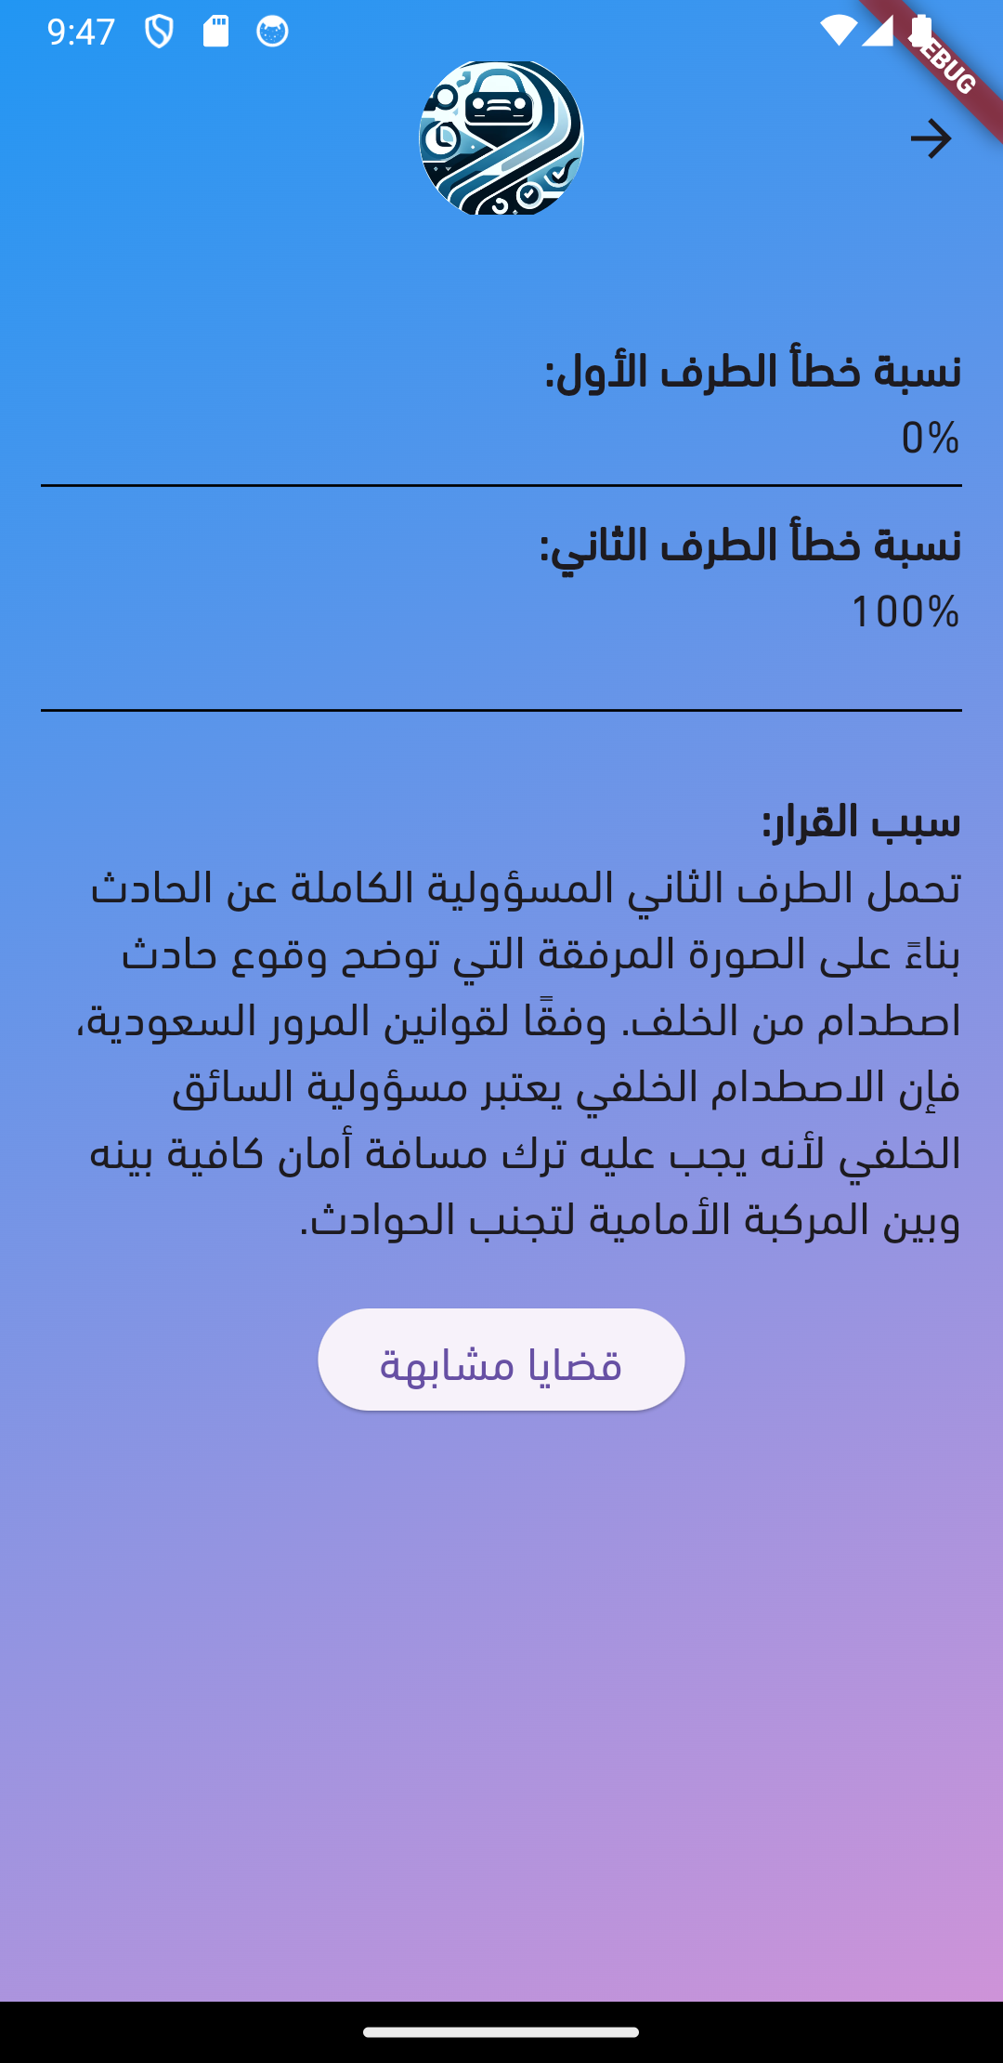
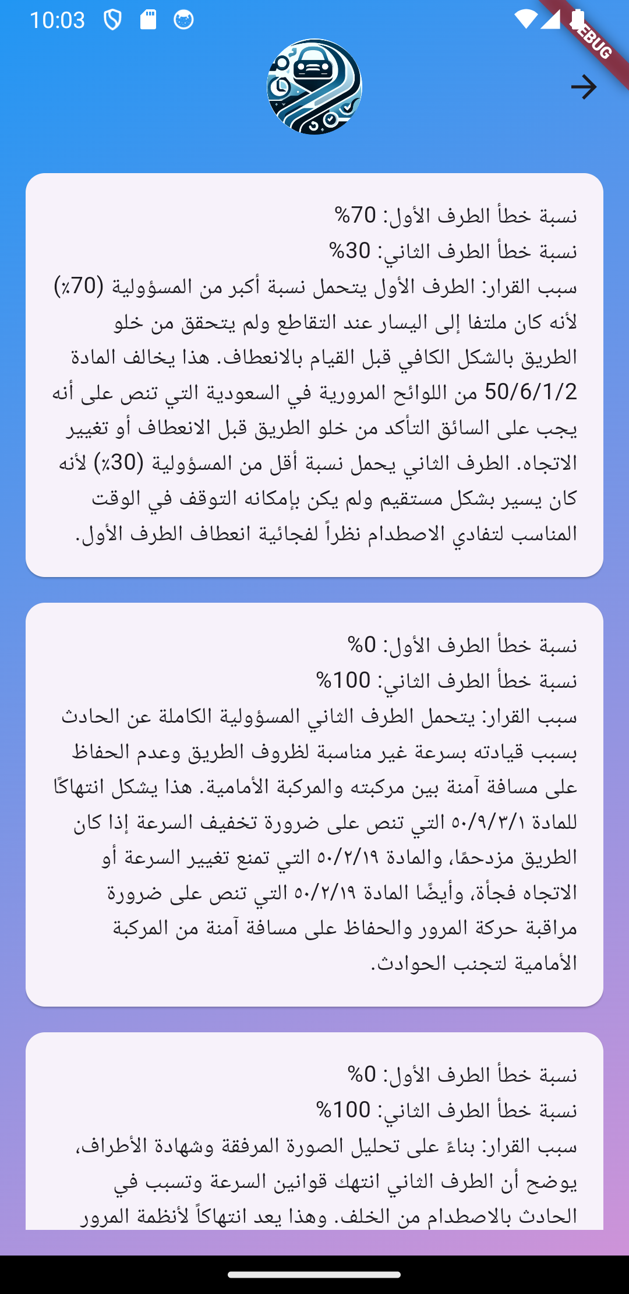
App Functionality

Slide 16


Live Demo
https://www.kapwing.com/videos/666abdc4531d9737504f5dd6

Slide 17

Conclusion
Challenges:
Our main challenge was in Data Collection.
Flutter app deployment
Future work:
Multi-Device Model Deployment.
App Integration with Absher.
Efficient Car Damage Assessment Model.

Slide 18
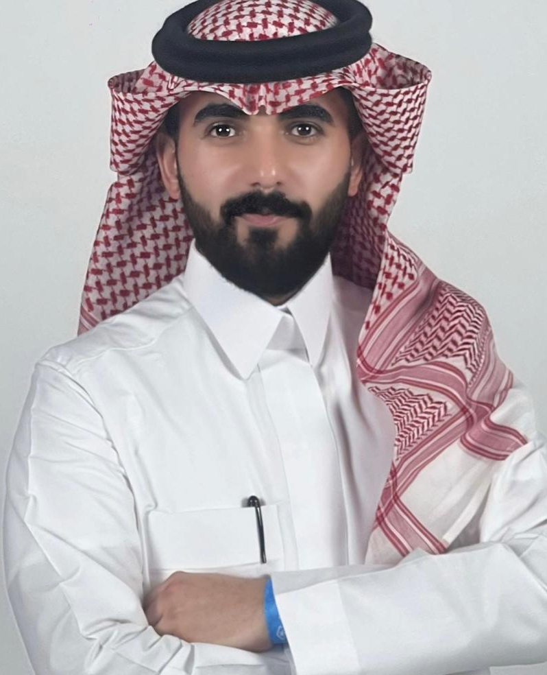
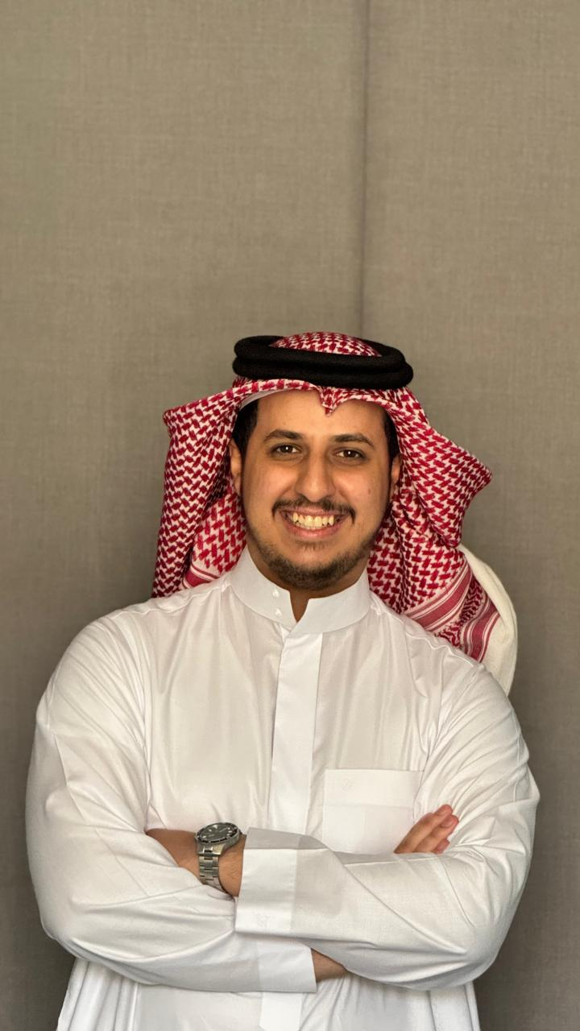




Team members
Khalid Saeed
Hamad AlRashoud
Sulaiman AlHarbi
Thank You

